Slide 1
Comparison of Simulation Results
Polar Codes
Lab 6 Group 3
Mentor : Bibin Sir

Slide 2
Contributors
Kaushik Prajapati (202201472)
Jeet Desai (202201474)
Tirth Modi (202201513)

Slide 3
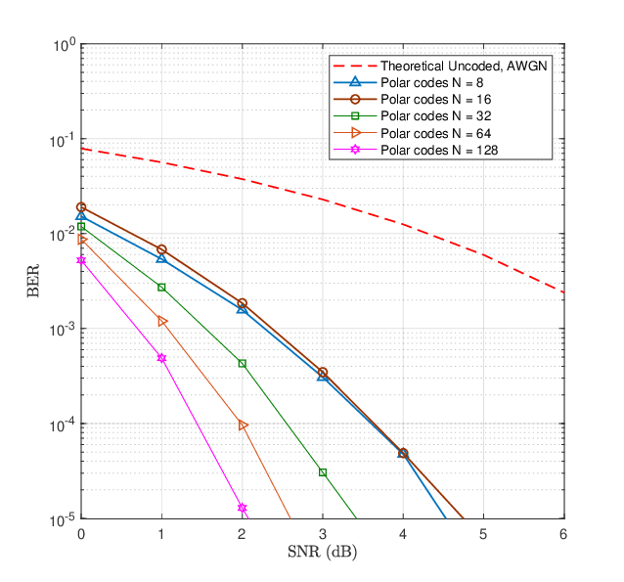
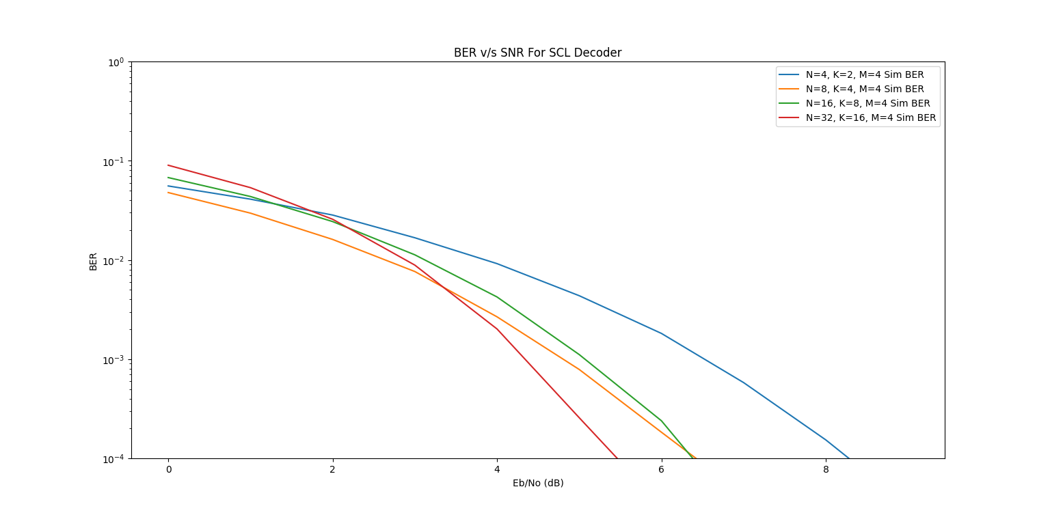
BER Plots
Simulated
Research Paper[1]

Slide 4
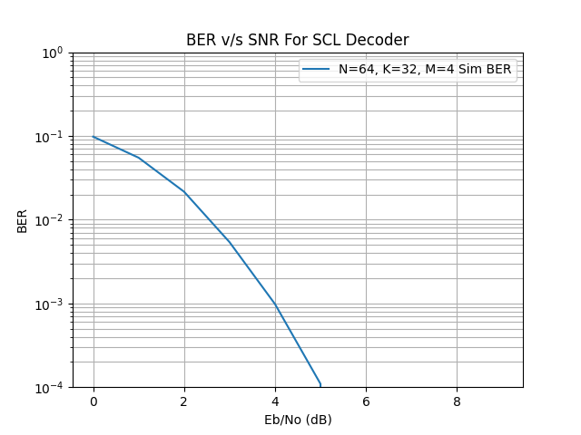
BER Plot for N=64,K=32
Simulated
Research Paper[1]

Slide 5
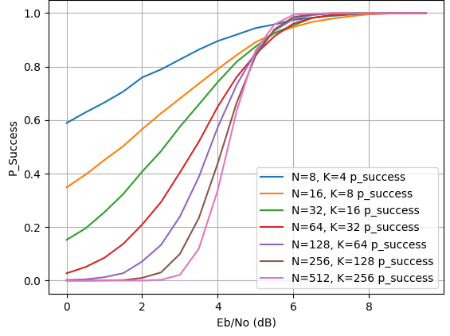
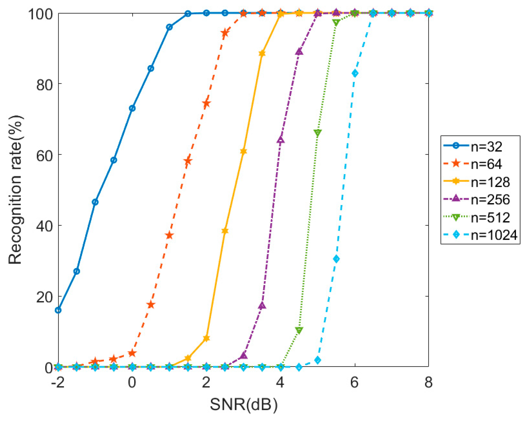
Success Probability Plots
Simulated
Research Paper[3]

Slide 6
References
[1] Investigating Bhattacharyya Parameters for Short and Long Polar Codes in AWGN and Rayleigh Fading Channels by Obed Rhesa Ludiwiniananda Handoko,Khoirul Anwar and Budi Syihabuddin.
[2] Hardware Architecture for List Successive Cancellation Decoding of Polar Codes by Alexios Balatsoukas-Stimming, Alexandre J. Raymond,Warren J. Gross,Andreas Burg
[3] Polar Code Parameter Recognition Algorithm Based on Dual Space
by Hengyan Liu ,Zhaojun Wu,Limin Zhang,Wenjun Yan

